Slide 1
BIOL 4984: Data Investigators

Slide 2
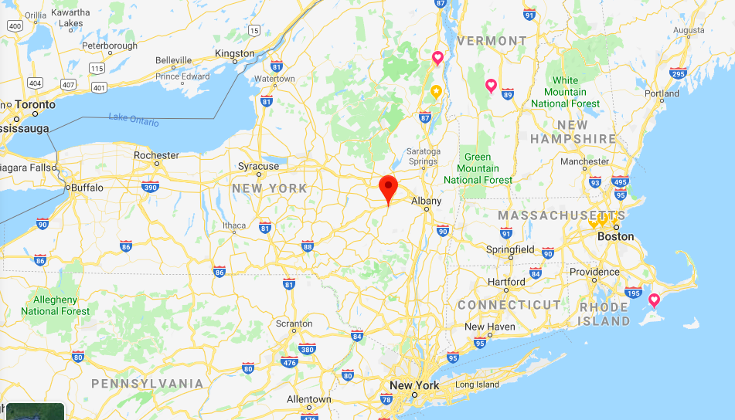
Dr. Kate Langwig
Upstate New York
B.S. 2008
Union College
Endangered Species Unit
New York State

Slide 3
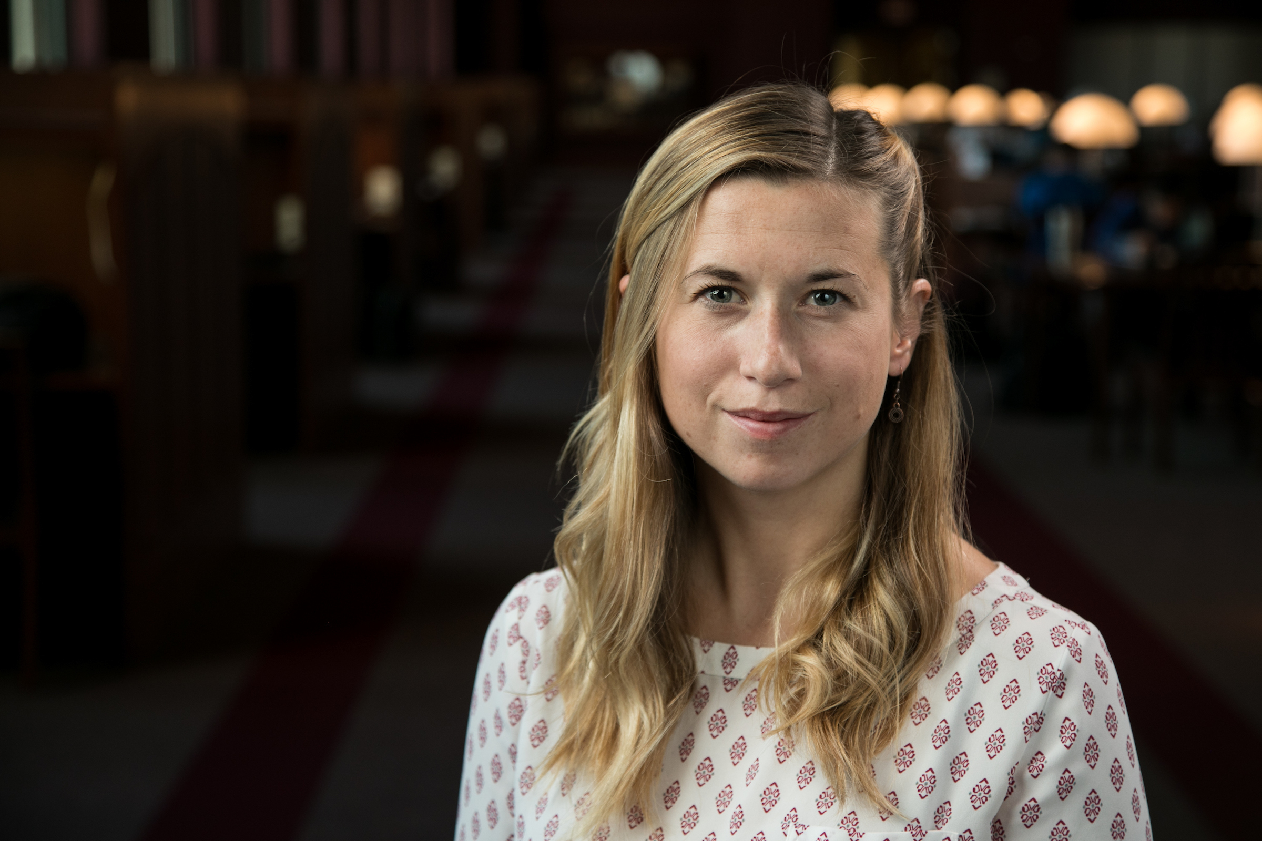
Higher Education
M.S.
Boston University
Ph.D. 2015
UC Santa Cruz
Post-doc 2015-17
Harvard
Assistant Professor 2017
Virginia Tech

Slide 4
About me:
Quantitative field ecologist
Ecology and evolution of infectious disease
Two main areas of research:
Epidemiology (including vaccines)
Fish, frogs, birds, bats, humans (including COVID-19)
Disease ecology
Mostly bats

Slide 5
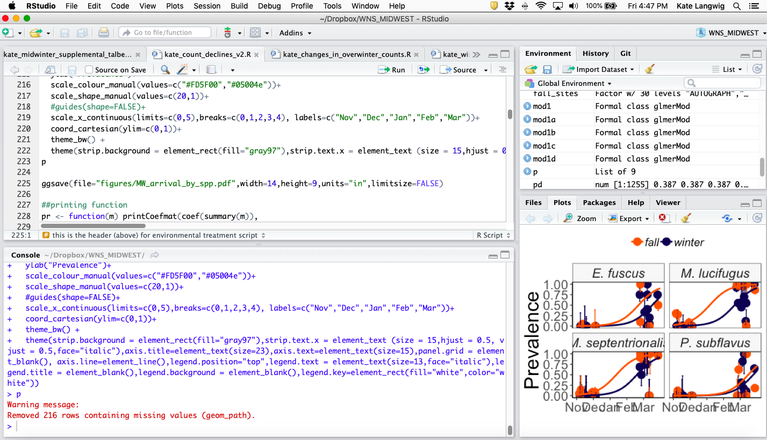
Quantitative Work

Slide 6
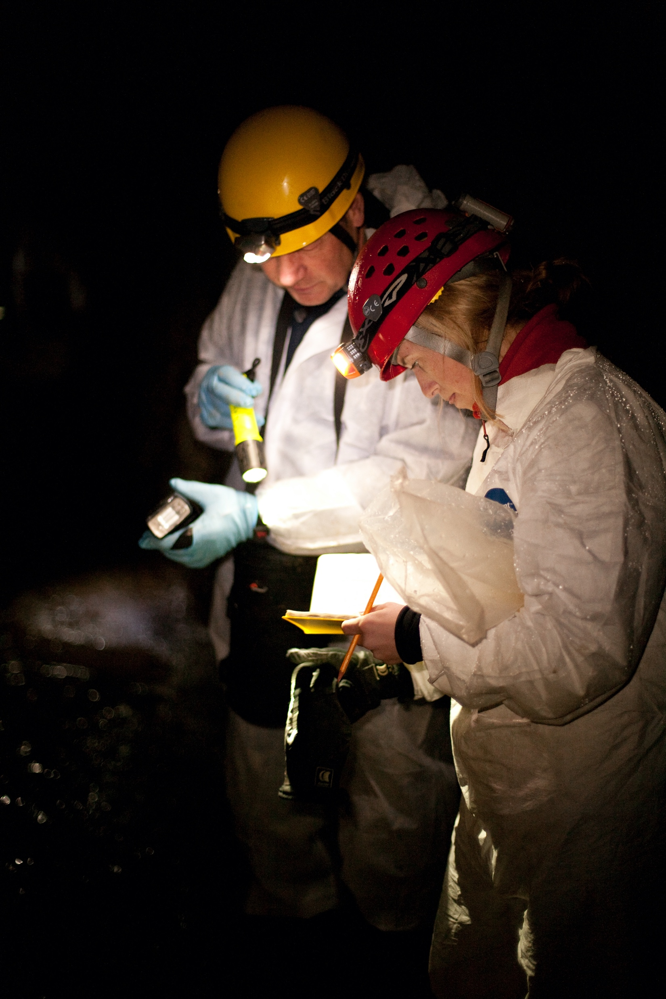
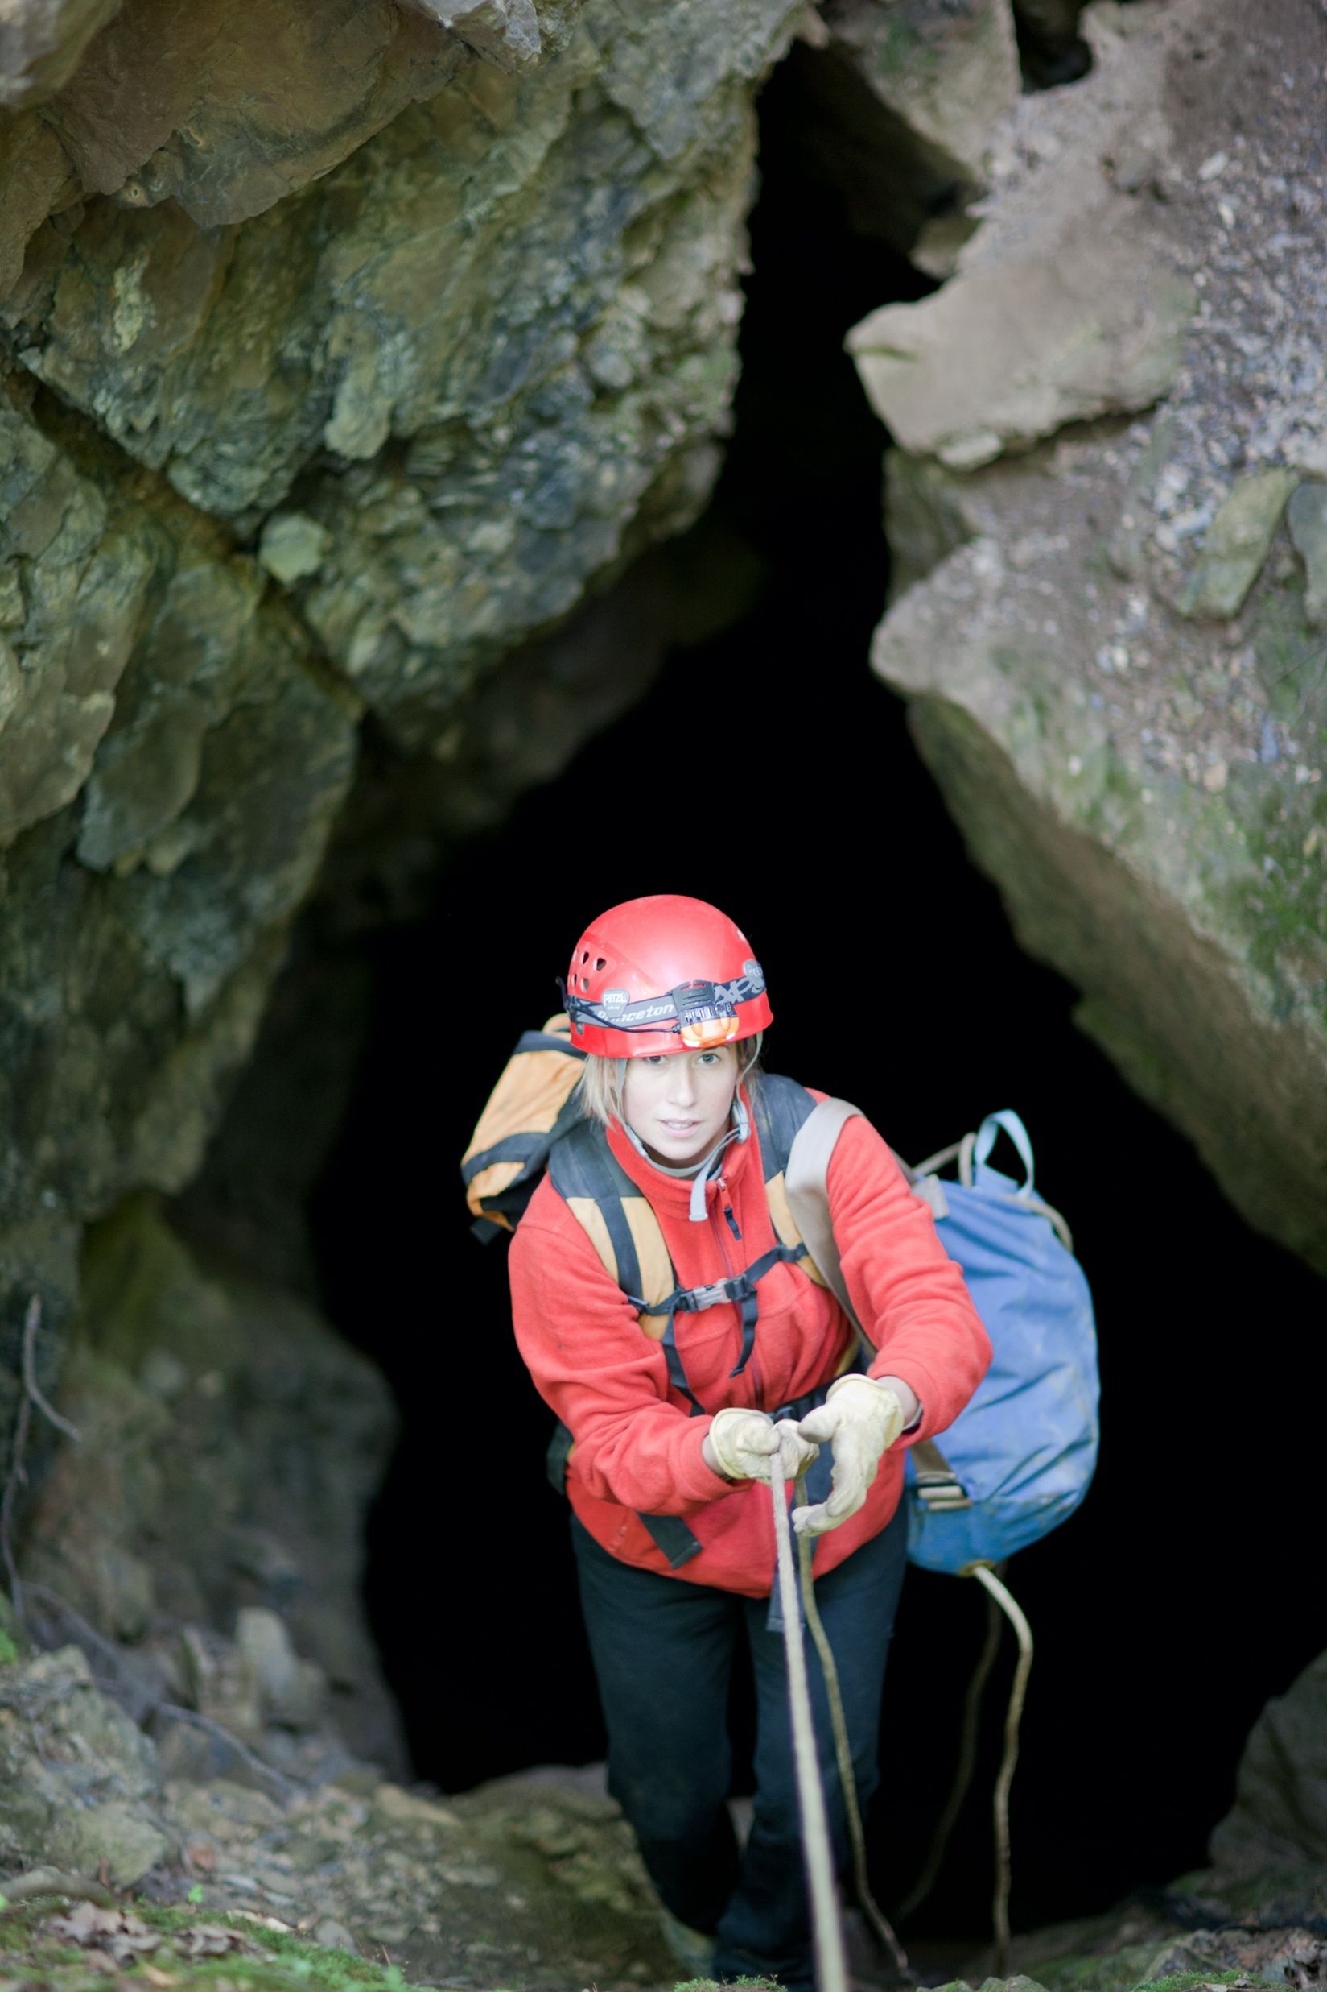
Field Work

Slide 7
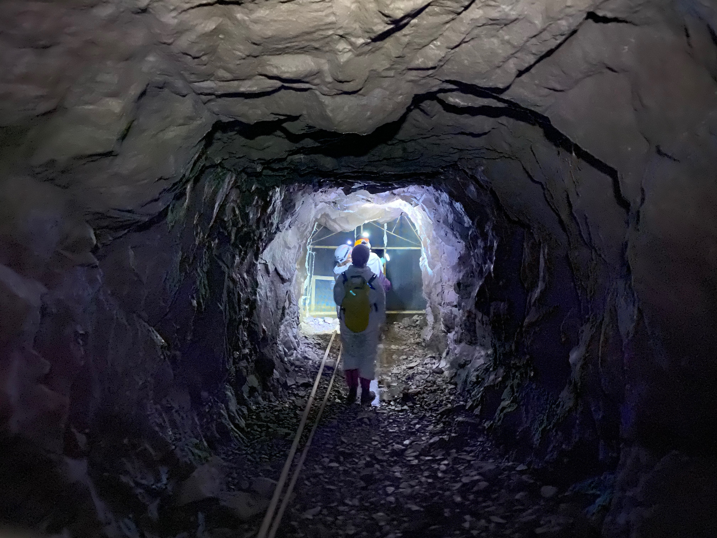
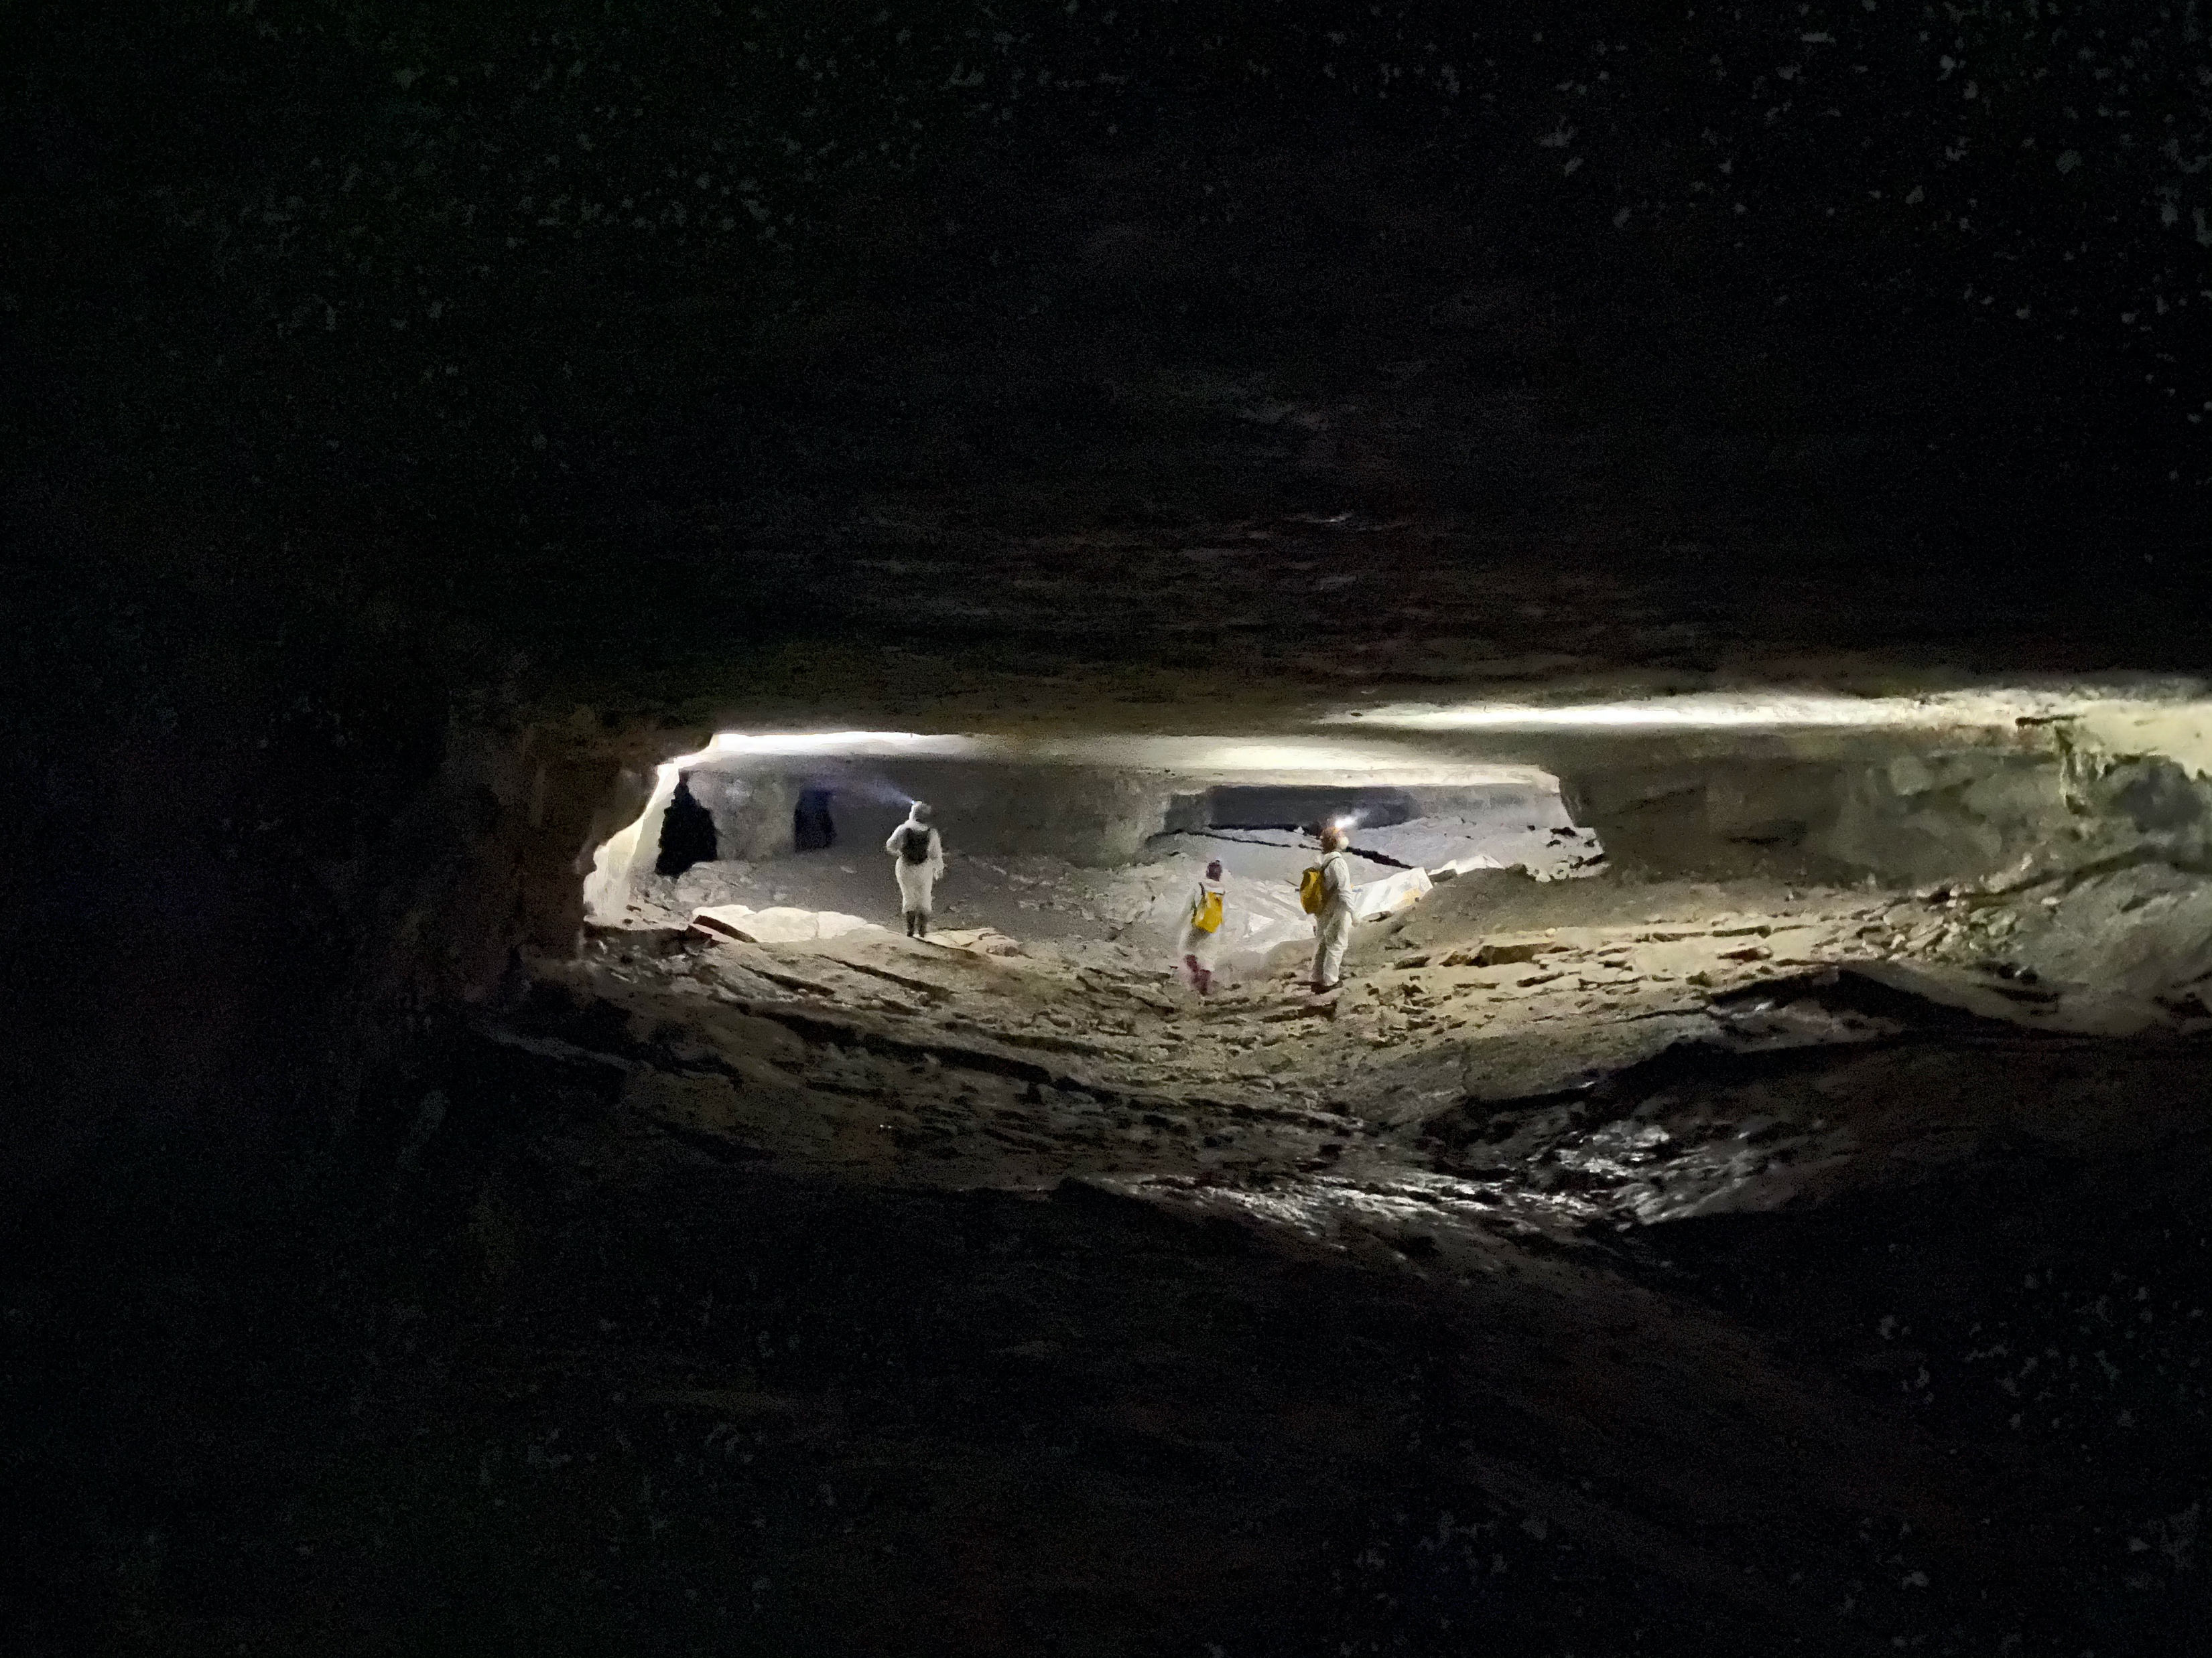
My field work

Slide 8
About you
Share what you want, and send a message on Canvas with all:
What should we call you?
What pronouns should we use when referring to you?
What is your year/Major?
What experience do you have working with data?
What are you excited to learn in this class?
Please provide a previous description of your R experience.

Slide 9
What will I learn
The overarching goal of this course is to provide an in-depth exploration of the process of conducting biological research – with the aim of answering the question: What do biologists do AFTER they’ve collected their data?
Specifically, this course is designed to help you:
Clean, reshape, and summarize messy datasets in R following open data best practices
Produce publication/public communication quality data visualizations in R
Develop reproducible analysis workflows following reproducible research best practices in R and RStudio
Practice version control with git and GitHub
Statistically analyze complex data in R

Slide 10
Syllabus
https://canvas.vt.edu/courses/223139

Slide 11
Assignments
https://docs.google.com/spreadsheets/d/1wrJyMB2GarLvCcgu6rTkHH0aZuFh_H-I84vAgMvf0Kw/edit?gid=0#gid=0

Slide 12
Module 1

Slide 13
Team Work
“The way in which our universities have divided up science does not reflect the way in which nature has divided up its problems.”
Kurt Salzinger PhD (2003)
What does this mean to you?

Slide 14
Team Science Facts
Most team science is conducted by small teams of 2-10 researchers
More than 90% of all publications in science and engineering are co-authored by teams of two or more
Team science can lead to results with greater scientific impact, innovation, productivity, and reach

Slide 15
Why don’t teams work well together?

Slide 16
Common problems
Team members lack a common vocabulary for communication across projects
It can be challenging to coordinate research tasks
Lack of trust in follow-through or skills
Goals are misaligned

Slide 17
So, What Does a Successful Team Look Like?
Clear communication among all team members
Regular brainstorming sessions with all team members participating
Consensus among all team members
Problem solving done by the group
Commitment to the project and the other team members
Regular team meetings are effective
Timely hand off from team members to ensure the project is moving in the right direction
Positive, supportive working relationships among all team members

Slide 18
Team Dynamics to Avoid at All Costs
No clear roles
‘throw work over the wall’ – no coordination
work alone and don’t share information
don’t accept responsibility
Absent
Unclear expectations for credit
No leadership
Notes:
https://advancectr.brown.edu/resources/professional-development/how-succeed-team-science https://advancectr.brown.edu/resources/professional-development/why-you-need-science-prenup-successful-collaboration

Slide 19
Team Science ‘PreNup’
Create open discussion on a team’s purpose, goals, responsibilities, processes, and communication preferences
Have a written agreement that documents points of consensus related to team functioning and serves as an accountability tool
Set team norms, expectations, and guidelines to be referenced later and when conflicts arise
Notes:
https://www.isce.vt.edu/content/dam/isce_vt_edu/Managing%20Difference%20and%20Conflict_ISCE%20Workshop3.pdf

Slide 20
For each group assignment
Use shared google docs to assign tasks, and add notes. See example at the bottom of the collaboration agreement.
Keep this as a running note doc shared among your team and add me as a shared group member.

Slide 21
Collaboration Agreement Template
On Canvas, Files→Week 1
Example as PDF in files

